Slide 1

Data Analytics in Action
Mr. Tissana Tanaklang

Slide 2

Agenda
Data Analytics Concept & Power BI
Dashboard Design Principle & Data Storytelling
Business Dashboard Concept

Slide 3

Data Analytics Concept & Power BI

Slide 4


What is data?
Structured
Semi-structured
Unstructured
{
"firstName": "Joe",
"lastName": "Jones",
"address":
{
"streetAddress": "1 Main St.",
"city": "New York",
"state": "NY",
"postalCode": "10099"
},
"contact":
[
{
"type": "home",
"number": "555 123-1234"
},
{
"type": "email",
"address": "joe@litware.com"
}
]
}
Customer
ID | FirstName | LastName | Email | Address
1 | Joe | Jones | joe@litware.com | 1 Main St.
2 | Samir | Nadoy | samir@northwind.com | 123 Elm Pl.
Dear Joe,
Thank you for ordering your hardware supplies from our online store (order number 1000) on 1/1/2022.
Your order has been shipped and should arrive in 3-5 business days.
{
"firstName": "Samir",
"lastName": "Nadoy",
"address":
{
"streetAddress": "123 Elm Pl.",
"unit": "500",
"city": "Seattle",
"state": "WA",
"postalCode": "98999"
},
"contact":
[
{
"type": "email",
"address": "samir@northwind.com"
}
]
}
Contoso Hardware
Our products are of the highest quality and used by professionals.
We have amazing screwdrivers, that are really useful for tightening and loosening screws.
We also have wrenches (or, if you prefer, spanners)…
Product
ID | Name | Price
123 | Hammer | 2.99
162 | Screwdriver | 3.49
201 | Wrench | 4.25

Slide 5
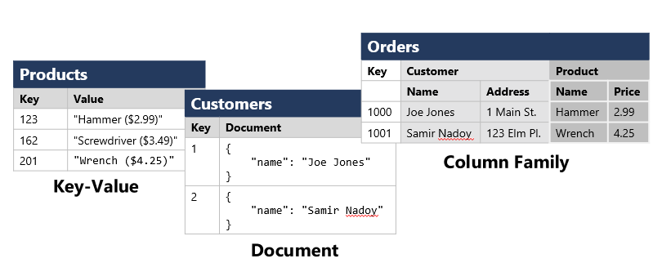
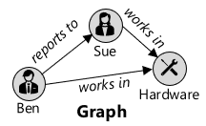
How is data stored?
Files
Databases
Delimited Text
FirstName,LastName,Email
Joe,Jones,joe@litware.com
Samir,Nadoy,samir@northwind.com
Relational
Customer
ID | Email | Address
1 | joe@litware.com | 1 Main St.
2 | samir@northwind.com | 123 Elm Pl.
Product
ID | Name | Price
123 | Hammer | 2.99
162 | Screwdriver | 3.49
201 | Wrench | 4.25
JavaScript Object Notation (JSON)
{
"customers":
[
{ "firstName": "Joe", "lastName": "Jones"},
{ "firstName": "Samir", "lastName": "Nadoy"}
]
}
Order
OrderNo | OrderDate | Customer
1000 | 1/1/2022 | 1
1001 | 1/1/2022 | 2
LineItem
OrderNo | ItemNo | ProductID | Quantity
1000 | 1 | 123 | 1
1000 | 2 | 201 | 2
1001 | 1 | 123 | 2
Non-Relational
Extensible Markup Language (XML)
<Customer firstName="Joe" lastName="Jones"/>
Binary Large Object (BLOB)
10110101101010110010...
Optimized formats:
Avro, ORC, Parquet

Slide 6

Data Analytics Lifecycle
CRISP-DM (Cross-industry standard process for data mining)
https://en.wikipedia.org/wiki/Cross-industry_standard_process_for_data_mining#/media/File:CRISP-DM_Process_Diagram.png

Slide 7
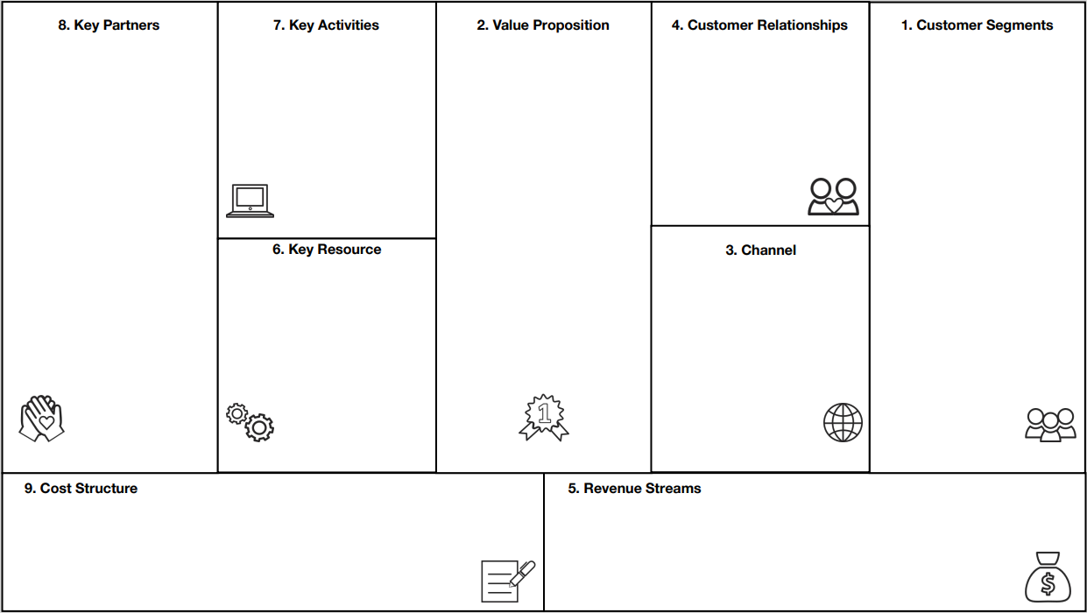
Business Understanding
Identify business pain points
Define key business questions
Choose key business areas of interest
https://www.sub-brain.com/business/business-model-canvas-sbc/

Slide 8
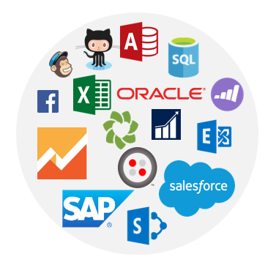
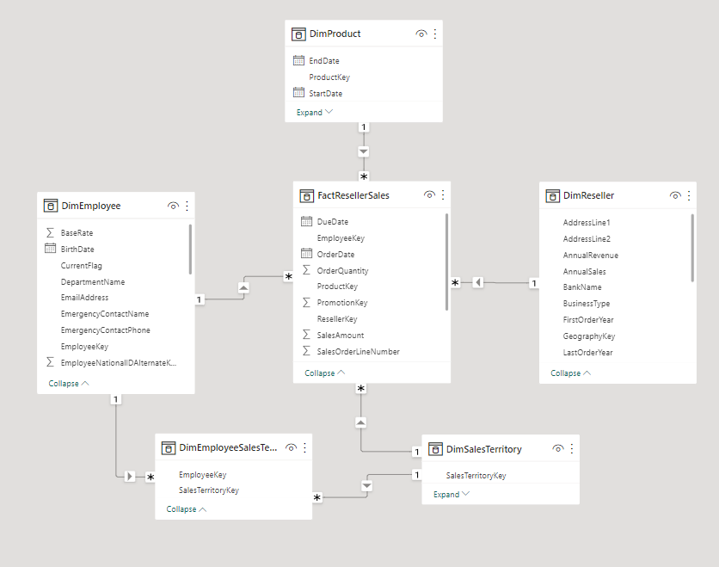
Data Understanding
Identify data sources
Understand limitation of each source
Understand data relationships

Slide 9
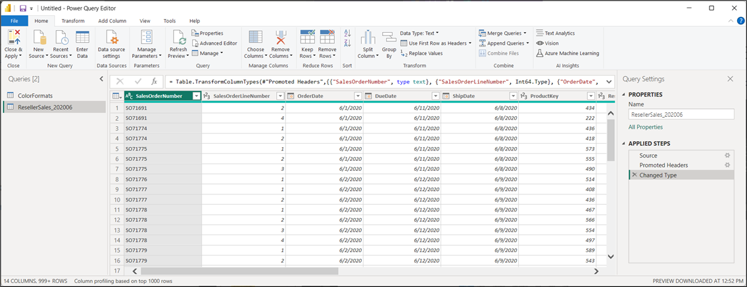
Data Preparation
Data layout design
Formatting data
Validating and cleansing data
Aggregating data
https://www.sub-brain.com/business/business-model-canvas-sbc/

Slide 10

Modeling
explores data to learn about relationships between variables and subsequently.
selects key variables and the most suitable models.
develop data sets for training, testing, and production purposes.
builds and executes models based on the work done in the model planning phase.
https://www.geeksforgeeks.org/

Slide 11
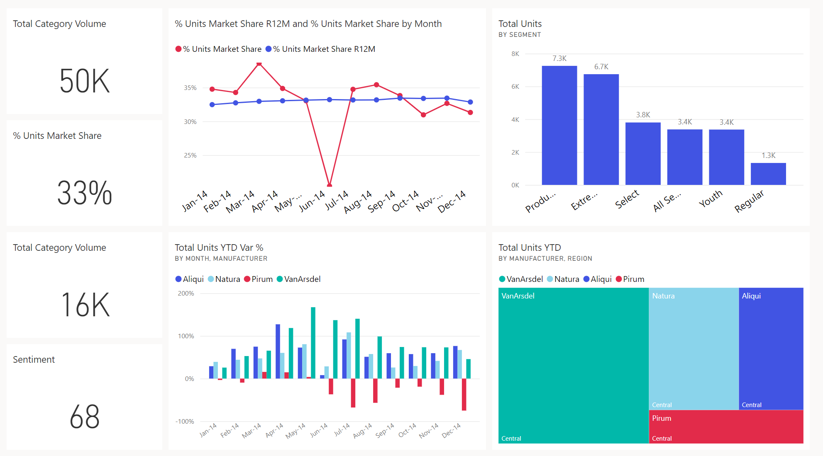



















From data to business insights with Power BI
https://learn.microsoft.com/

Slide 12
Different types of analysis
Data analysis is another form of storytelling with five categories:
Descriptive : Summarize past data
Diagnostic : Explain past data
Predictive : Forecast future data
Prescriptive : Optimize future data
Cognitive : Learn from data
https://learn.microsoft.com/

Slide 13
Tasks of a Data Analyst
Prepare
Model
Visualize
Manage
Analyze
https://learn.microsoft.com/

Slide 14
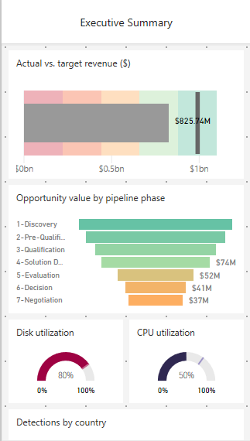
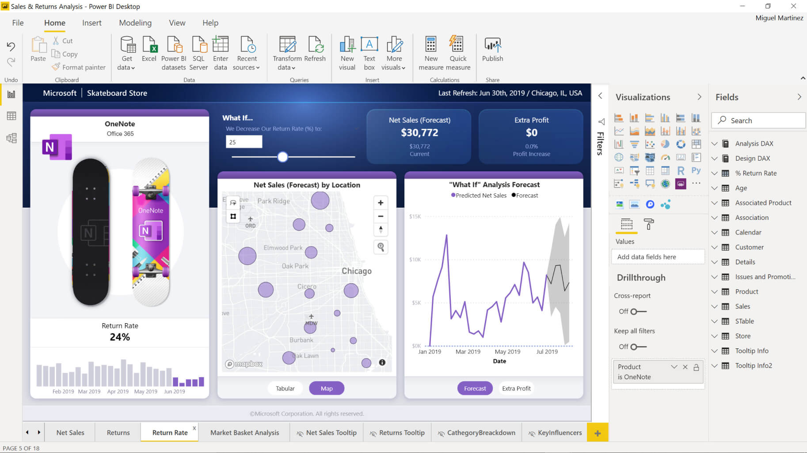
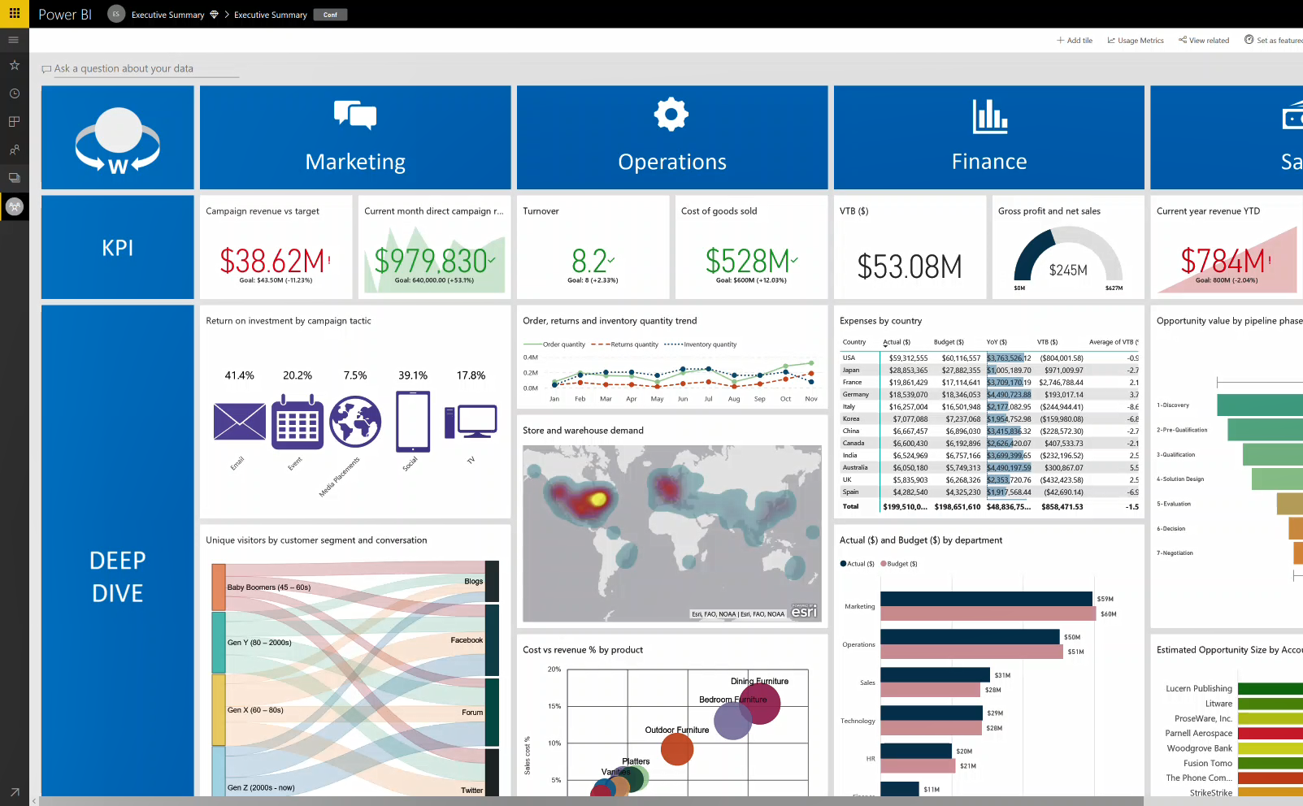
Microsoft Power BI
https://learn.microsoft.com/

Slide 15


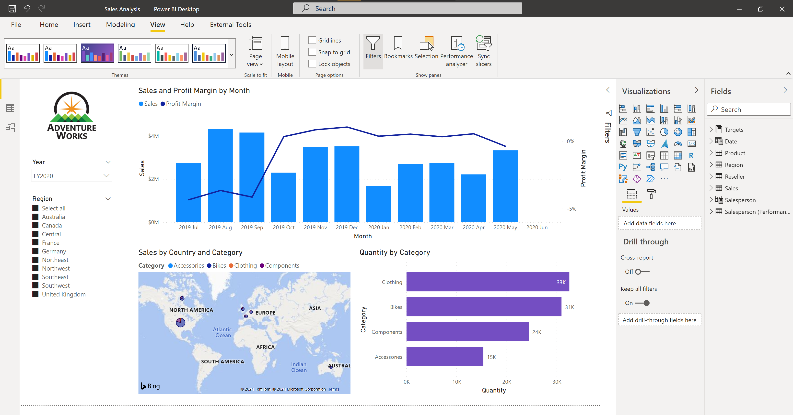




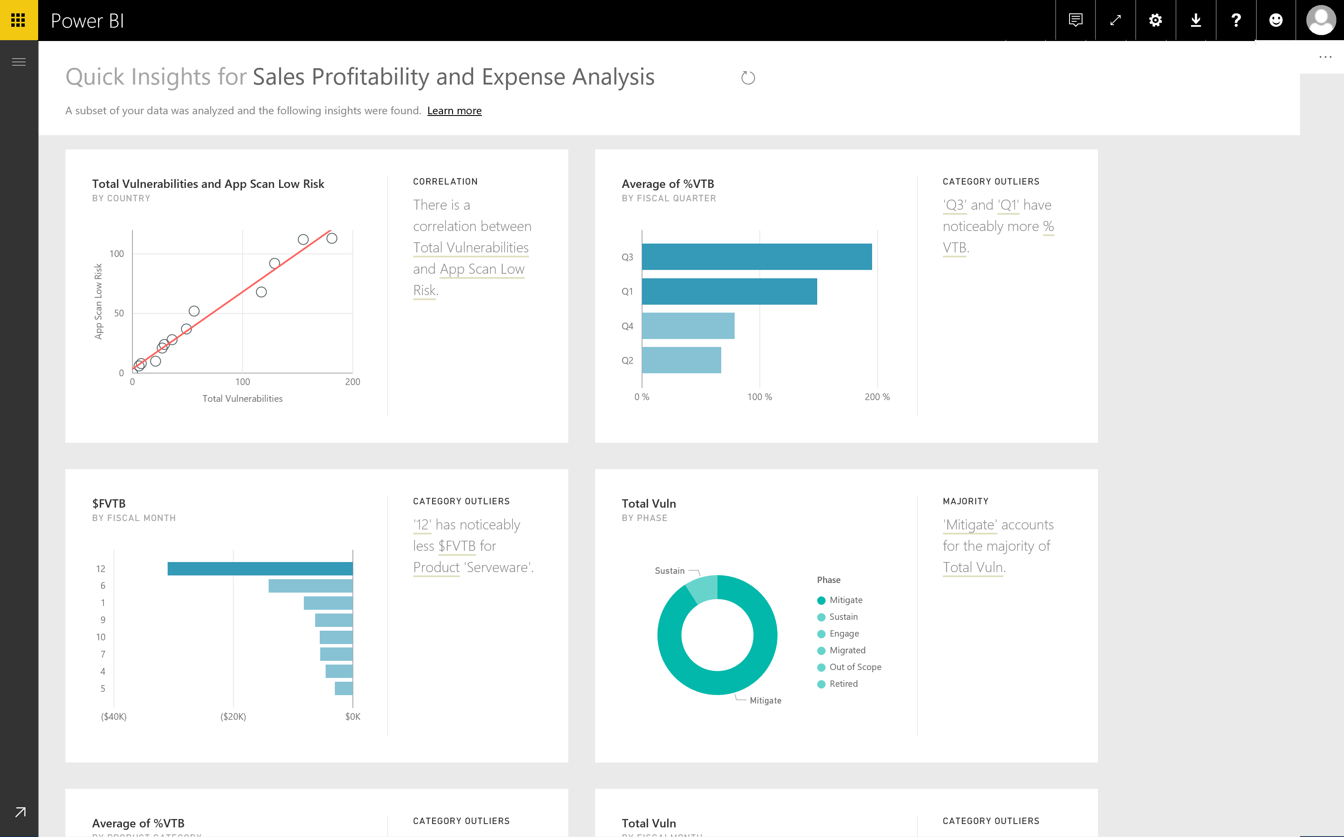
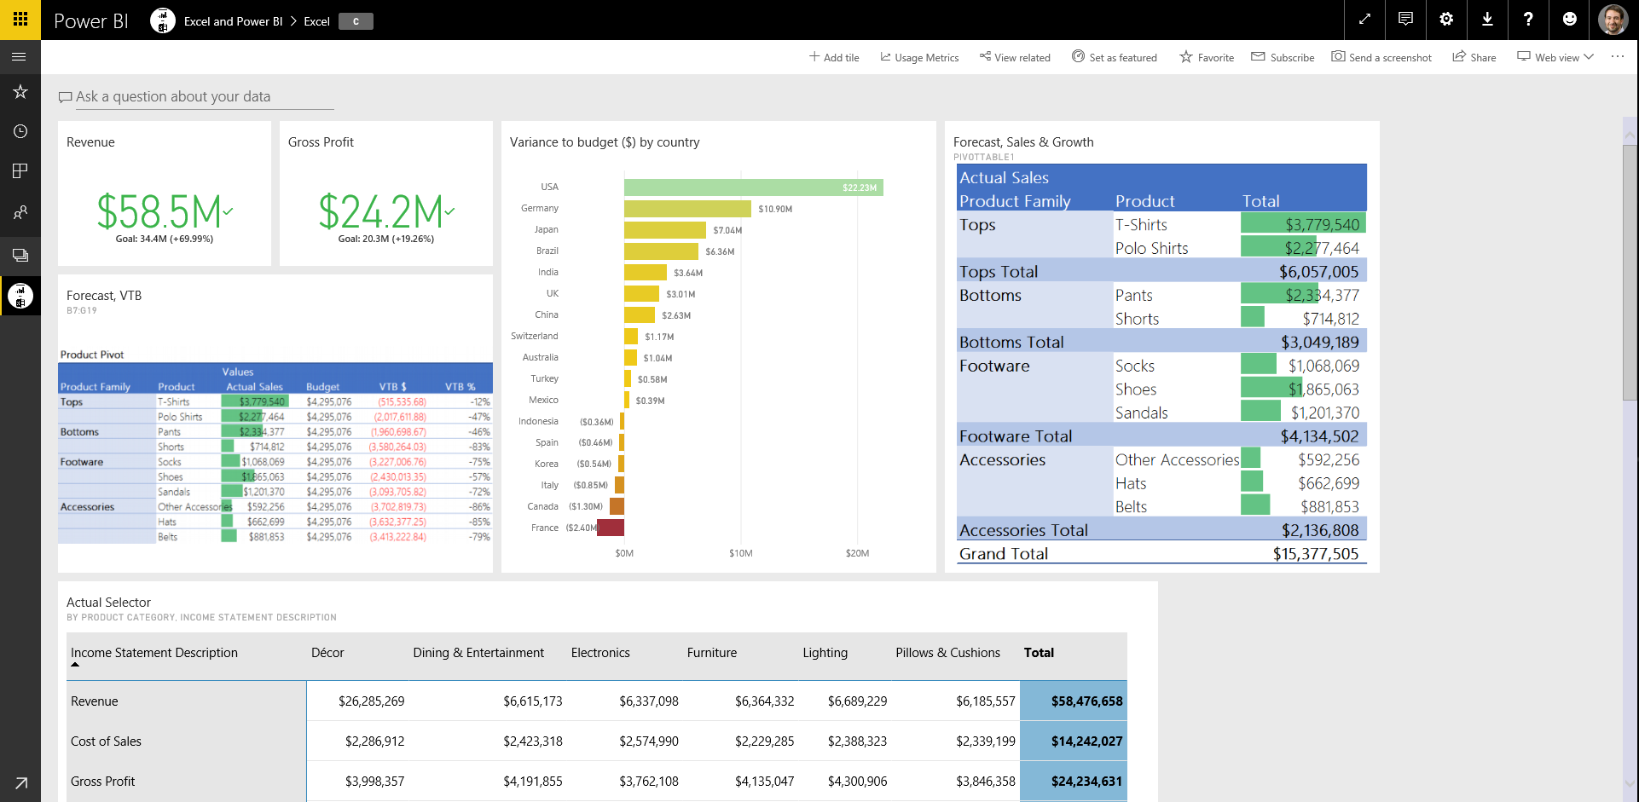
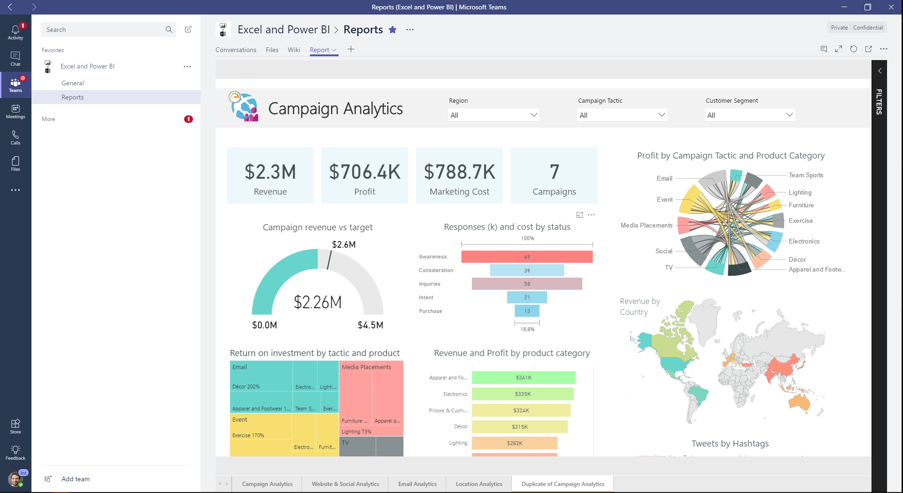
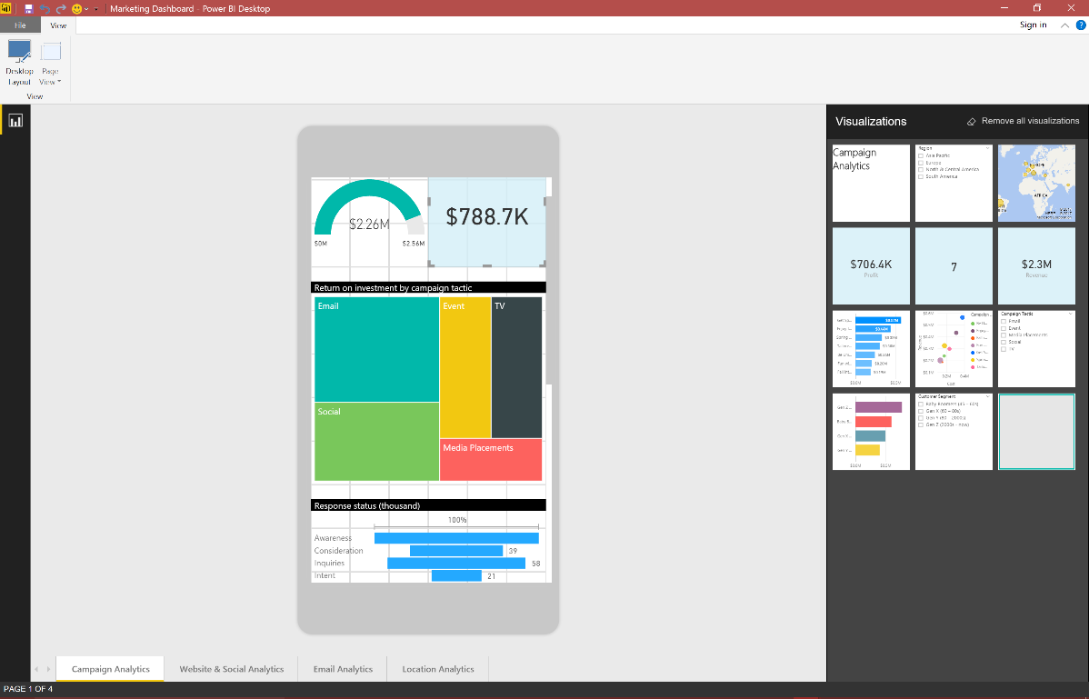

The flow of Power BI
Data sources
Power BI Desktop
Power BI service & Mobile
https://learn.microsoft.com/

Slide 16
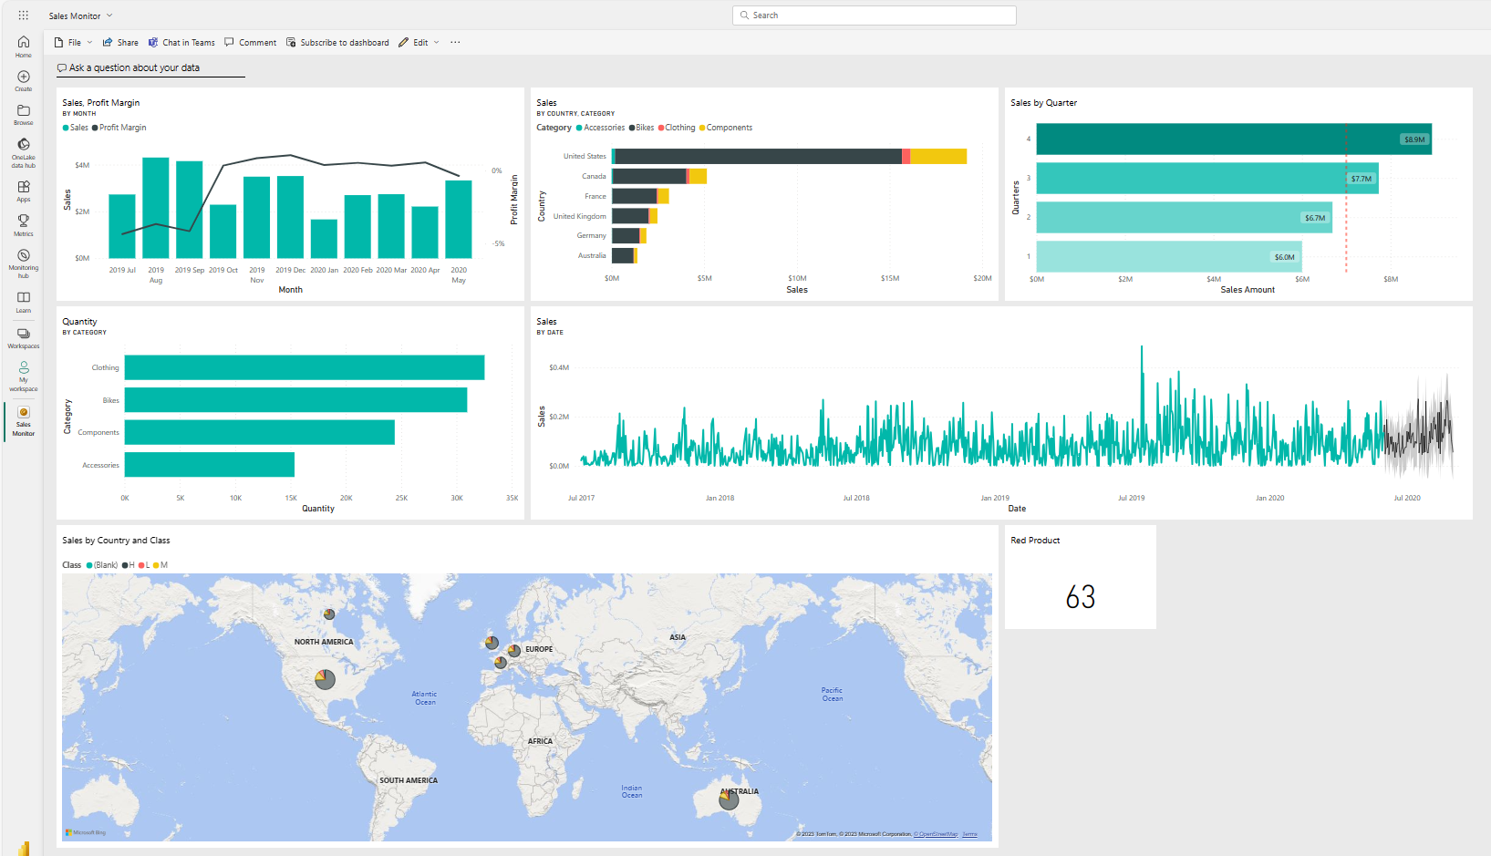
Power BI service
Single-page dashboards can be derived from reports in the service.
https://learn.microsoft.com/

Slide 17
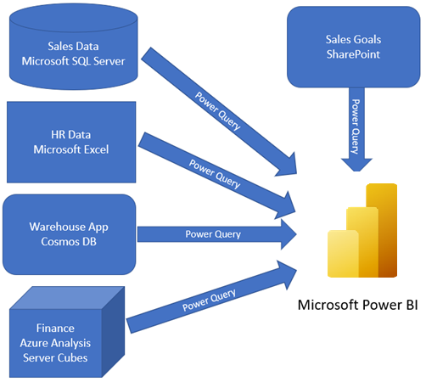
Get data in Power BI
Combine all data into a single dataset
https://learn.microsoft.com/

Slide 18
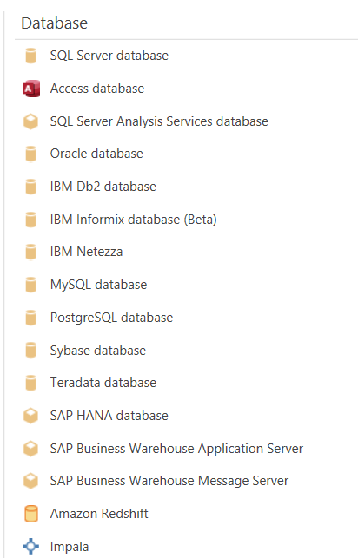
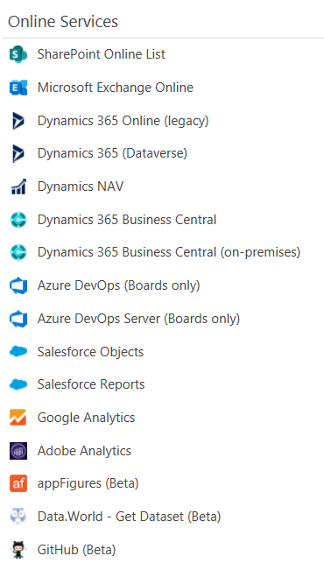
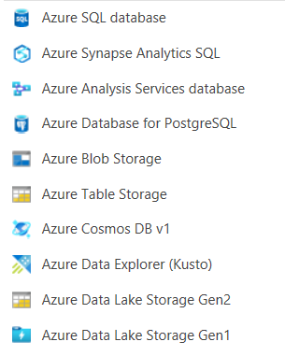
Data Source
https://learn.microsoft.com/

Slide 19
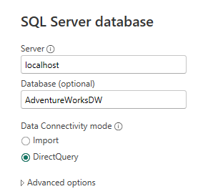
Select a storage mode
Storage mode affects
Available transformations
Report performance
*Not all sources support all modes *
https://learn.microsoft.com/

Slide 20
Implications of using DirectQuery
Benefits
Frequently changing data
Need near real-time
Large data volumes
Multi-dimensional data
Limitations
Dependent on data source performance
Security between source and destination
Limited modeling capabilities
Limited transformation features
https://learn.microsoft.com/

Slide 21
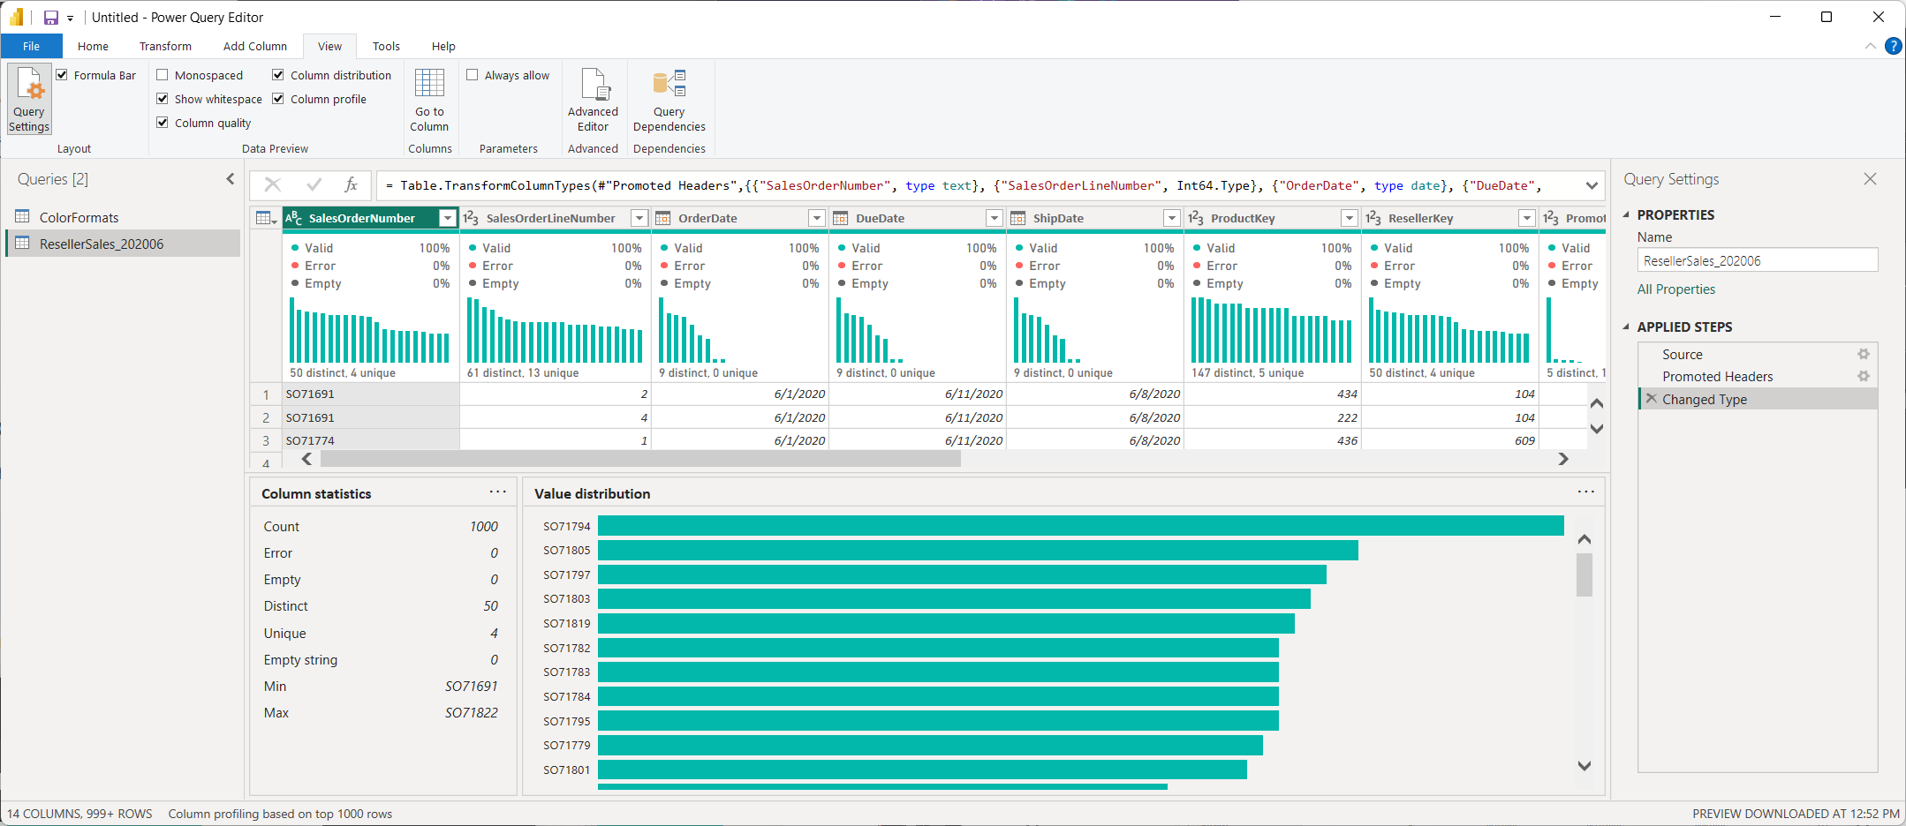
Data profiling options in Power Query Editor
https://learn.microsoft.com/

Slide 22
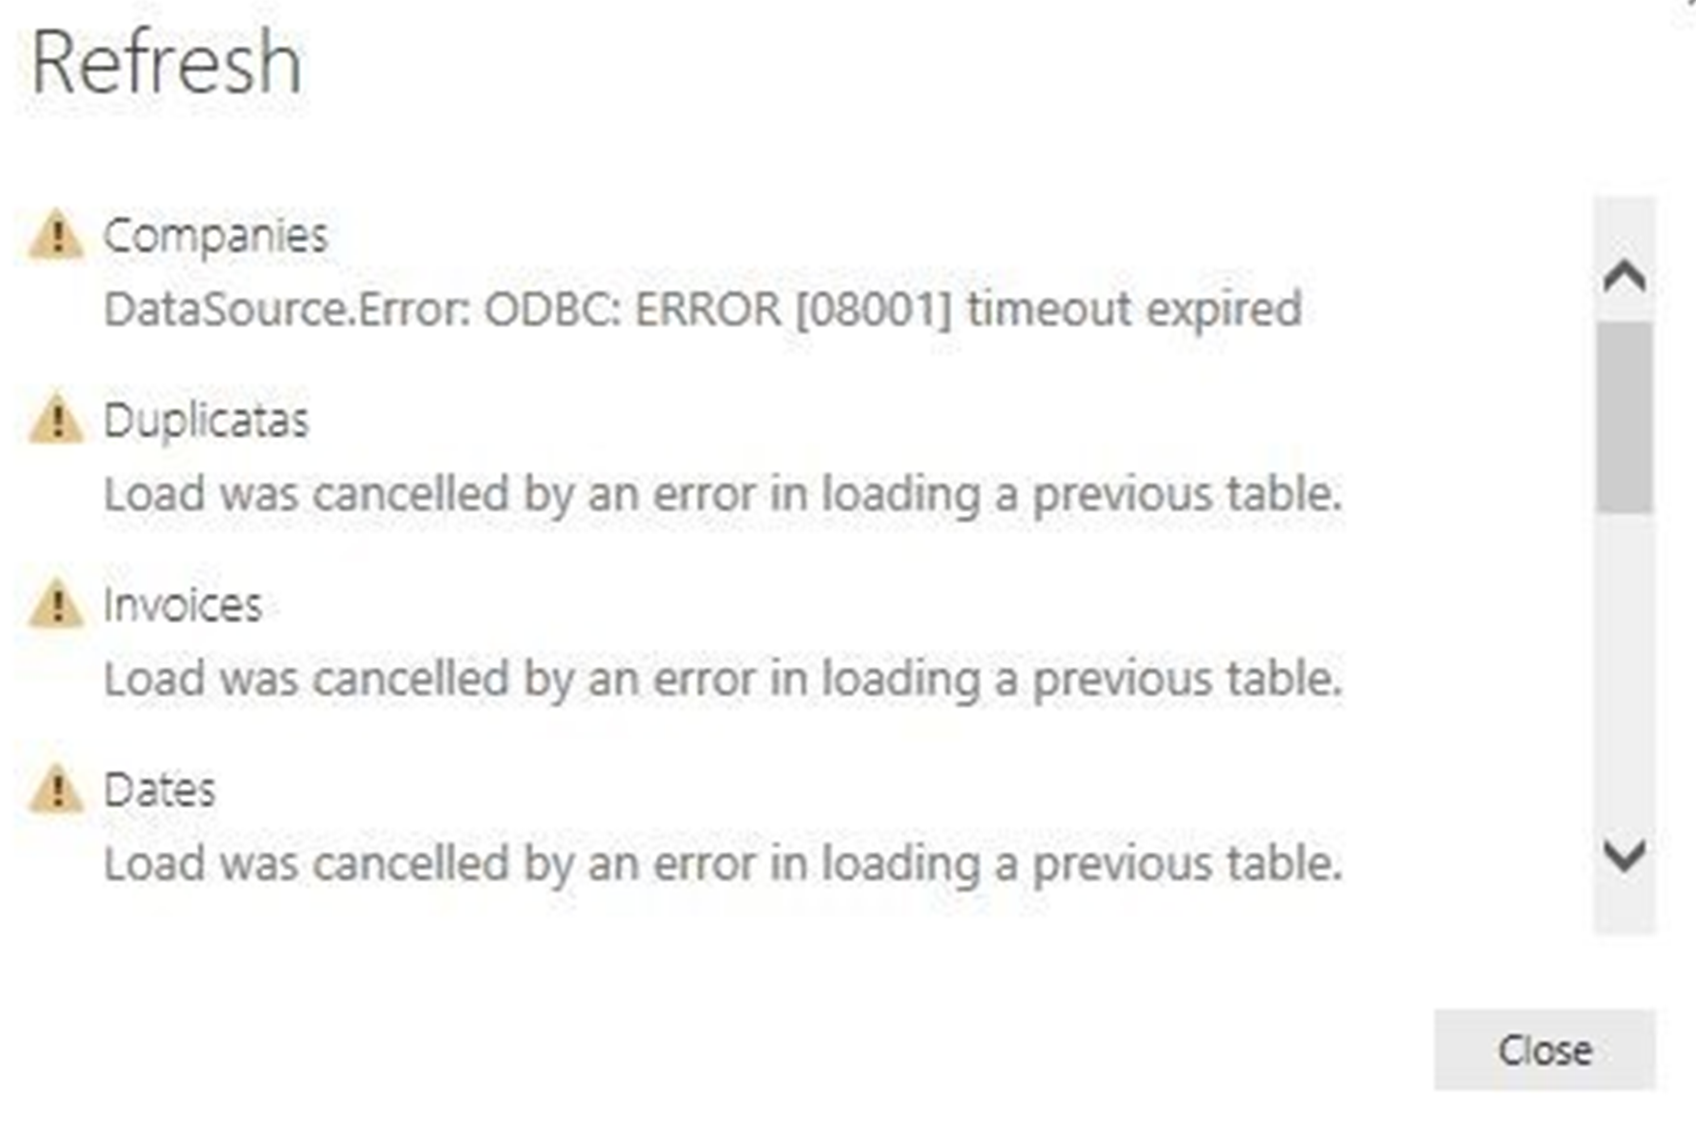
Data import errors
Query Timeout
Couldn’t find data formatted as a table
Could not find file
Data type errors
https://learn.microsoft.com/

Slide 23
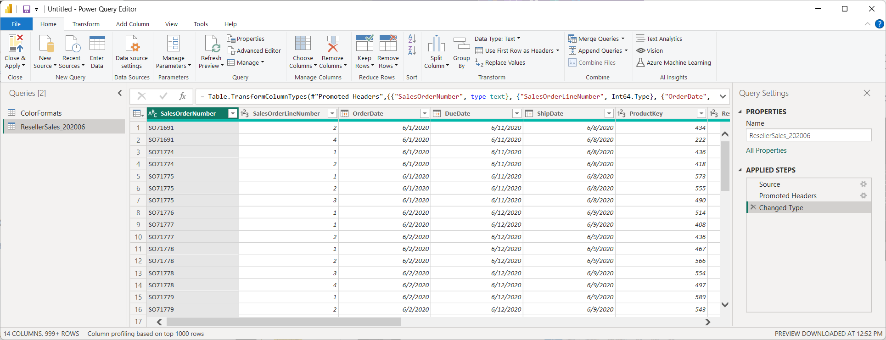
Transform data with Power Query Editor
https://learn.microsoft.com/

Slide 24
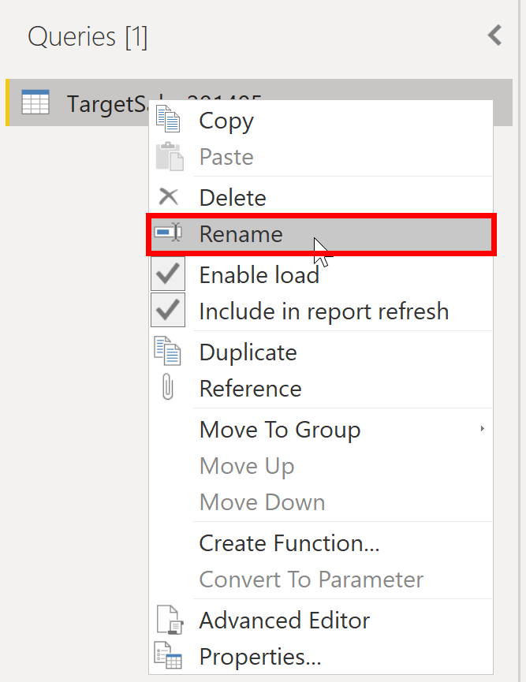
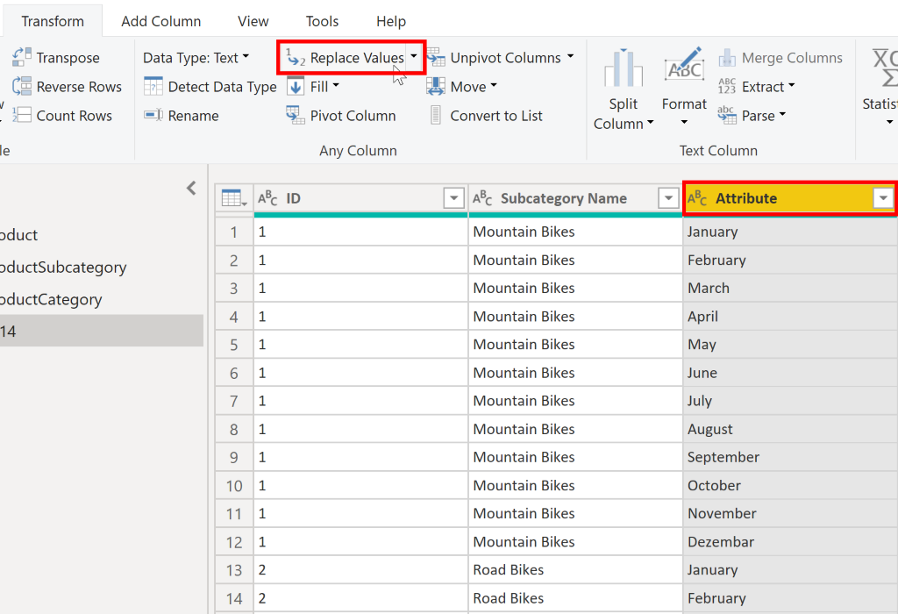
Choose user-friendly values
https://learn.microsoft.com/

Slide 25
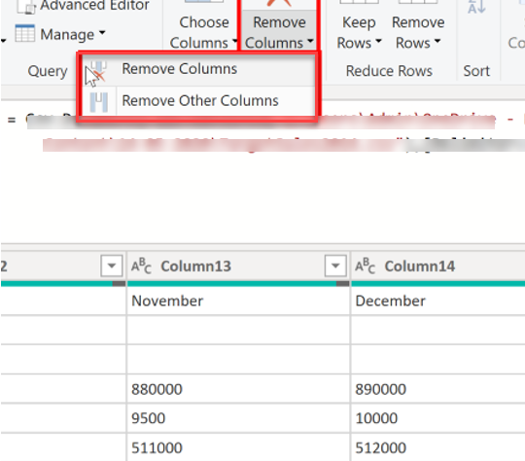
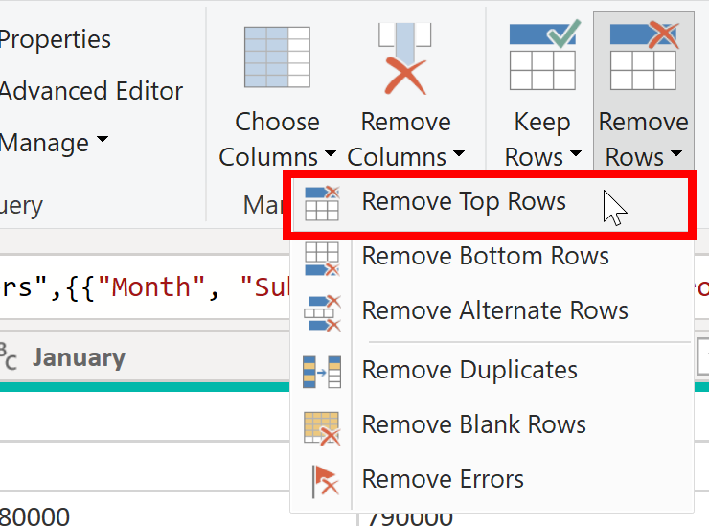
Shaping table structure
https://learn.microsoft.com/

Slide 26
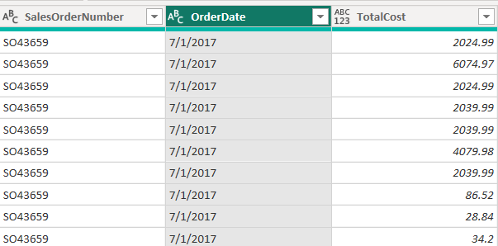
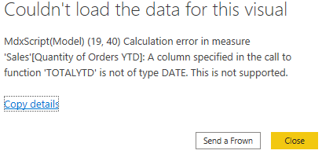
Evaluate and change column data types
https://learn.microsoft.com/

Slide 27
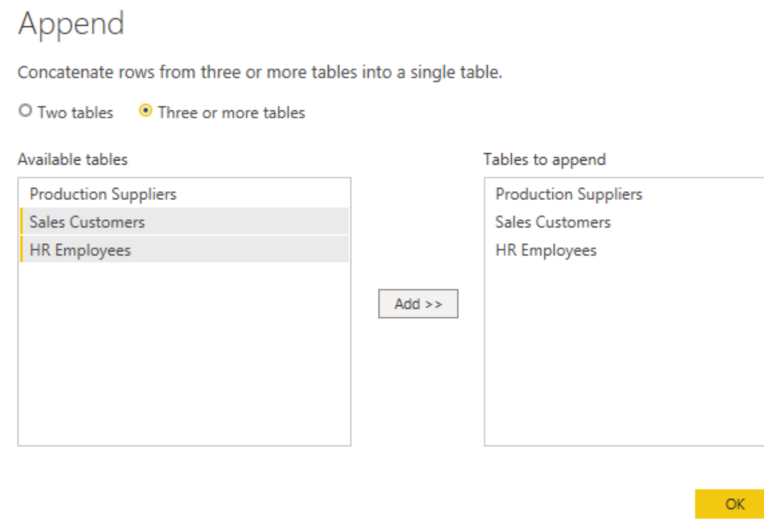
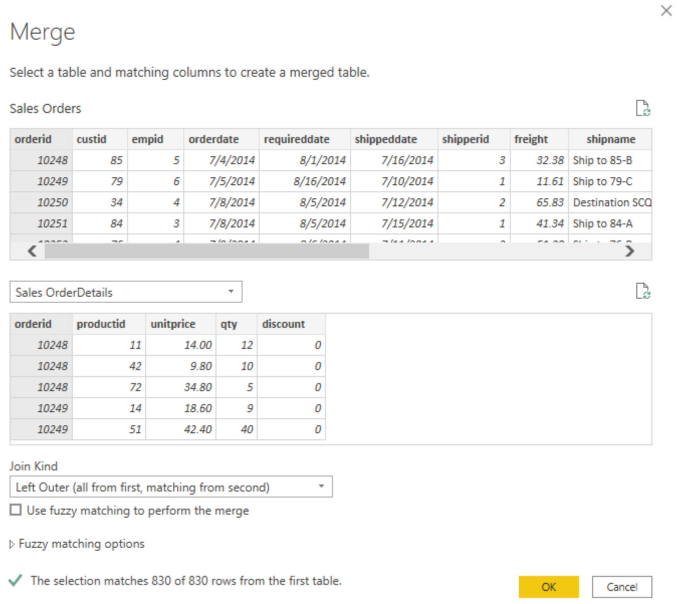
Combine multiple queries into one
https://learn.microsoft.com/

Slide 28
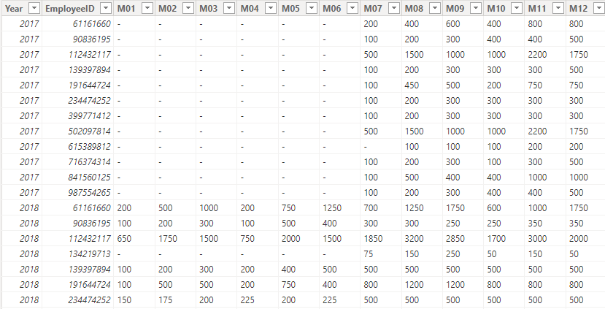
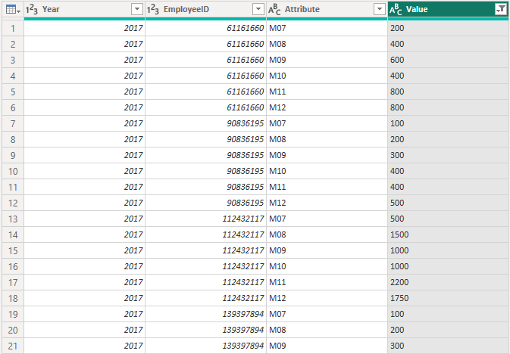
Unpivot or pivot columns
https://learn.microsoft.com/

Slide 29
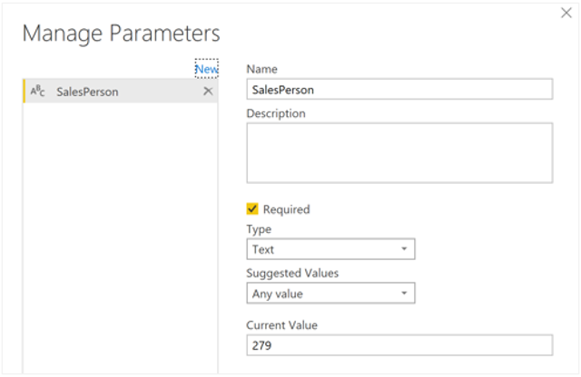
Performance recommendations
Only keep necessary data
Check data types
Reduce cardinality
Disable query load
Use parameters
https://learn.microsoft.com/

Slide 30
Model data with Power BI Desktop
Data types
Star schema
Create relationships
Edit relationships
Create hierarchies
https://learn.microsoft.com/

Slide 31
Relational tables
Customer
ID | FirstName | MiddleName | LastName | Email | Address | City
1 | Joe | David | Jones | joe@litware.com | 1 Main St. | Seattle
2 | Samir |  | Nadoy | samir@northwind.com | 123 Elm Pl. | New York
Data is stored in tables
Tables consists of rows and columns
All rows have the same columns
Each column is assigned a datatype
Product
ID | Name | Price
123 | Hammer | 2.99
162 | Screwdriver | 3.49
201 | Wrench | 4.25
Order
OrderNo | OrderDate | Customer
1000 | 1/1/2022 | 1
1001 | 1/1/2022 | 2
LineItem
OrderNo | ItemNo | ProductID | Quantity
1000 | 1 | 123 | 1
1000 | 2 | 201 | 2
1001 | 1 | 123 | 2
https://learn.microsoft.com/

Slide 32
Normalization
Customer
ID | FirstName | LastName | Address | City
1 | Joe | Jones | 1 Main St. | Seattle
2 | Samir | Nadoy | 123 Elm Pl. | New York
Sales Data |  | Sales
OrderNo | OrderDate | Customer | Product | Quantity
1000 | 1/1/2022 | Joe Jones, 1 Main St, Seattle | Hammer ($2.99) | 1
1000 | 1/1/2022 | Joe Jones- 1 Main St, Seattle | Screwdriver ($3.49) | 2
1001 | 1/1/2022 | Samir Nadoy, 123 Elm Pl, New York | Hammer ($2.99) | 2
… | … | … | … | …
Product
ID | Name | Price
123 | Hammer | 2.99
162 | Screwdriver | 3.49
201 | Wrench | 4.25
Order
OrderNo | OrderDate | Customer
1000 | 1/1/2022 | 1
1001 | 1/1/2022 | 2
LineItem
OrderNo | ItemNo | ProductID | Quantity
1000 | 1 | 123 | 1
1000 | 2 | 201 | 2
1001 | 1 | 123 | 2
https://learn.microsoft.com/

Slide 33
Other common database objects
Views
Stored Procedures
CREATE VIEW Deliveries
AS
SELECT o.OrderNo, o.OrderDate,
c.Address, c.City
FROM Order AS o JOIN Customer AS c
ON o.Customer = c.ID;
CREATE PROCEDURE RenameProduct
@ProductID INT,
@NewName VARCHAR(20)
AS
UPDATE Product
SET Name = @NewName
WHERE ID = @ProductID;
...
EXEC RenameProduct 201, 'Spanner';
Customer
… | … | …
… | … | …
Order
… | … | …
… | … | …
Deliveries
OrderNo | OrderDate | Address | City
1000 | 1/1/2022 | 1 Main St. | Seattle
1001 | 1/1/2022 | 123 Elm Pl. | New York
Product
ID | Name | Price
201 | Wrench Spanner | 4.25
https://learn.microsoft.com/

Slide 34
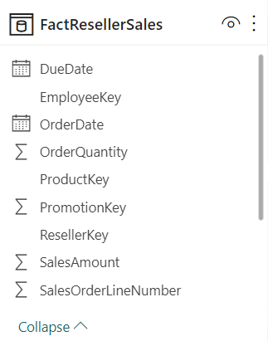
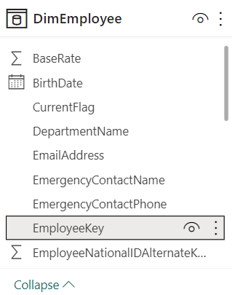
Data table types
Fact tables are activities or events.
Dimension tables provide the details.
https://learn.microsoft.com/

Slide 35
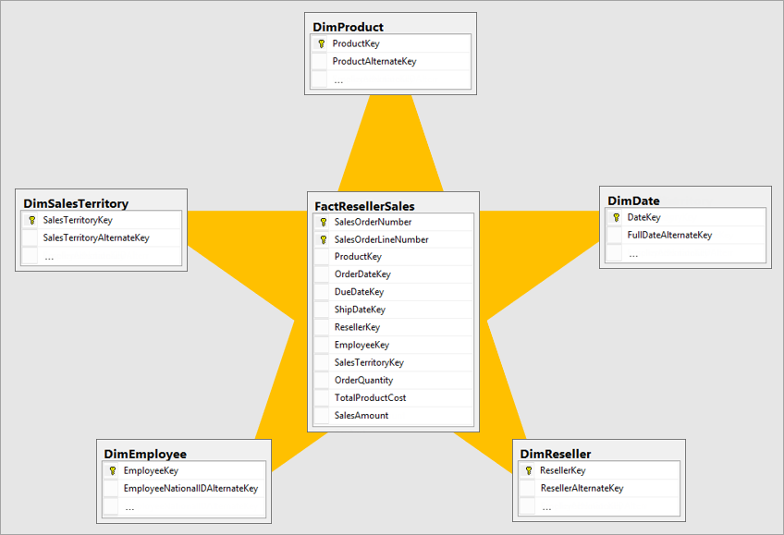
Understand star schemas
https://learn.microsoft.com/

Slide 36
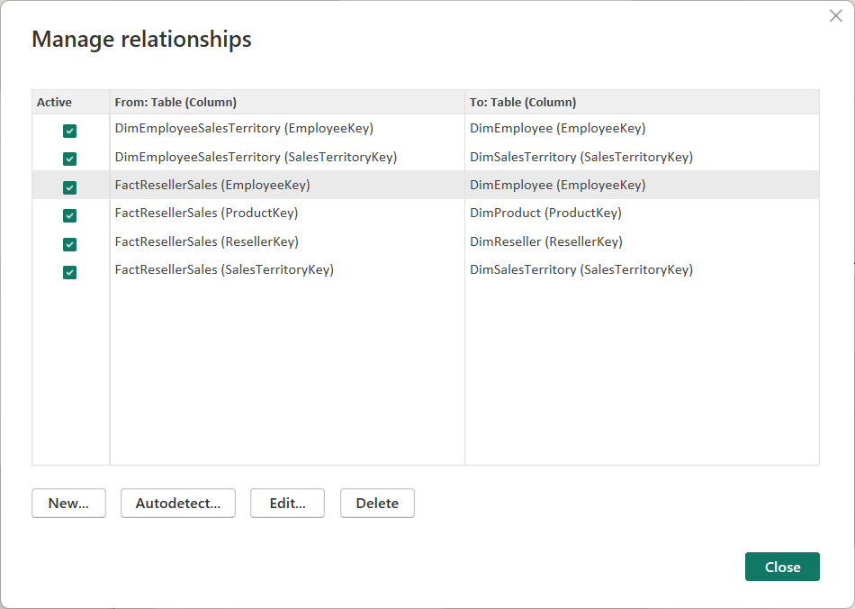
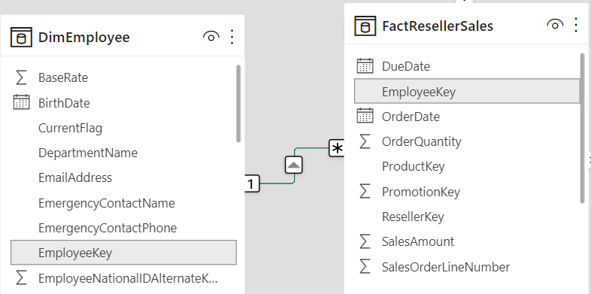
Create relationships
https://learn.microsoft.com/

Slide 37
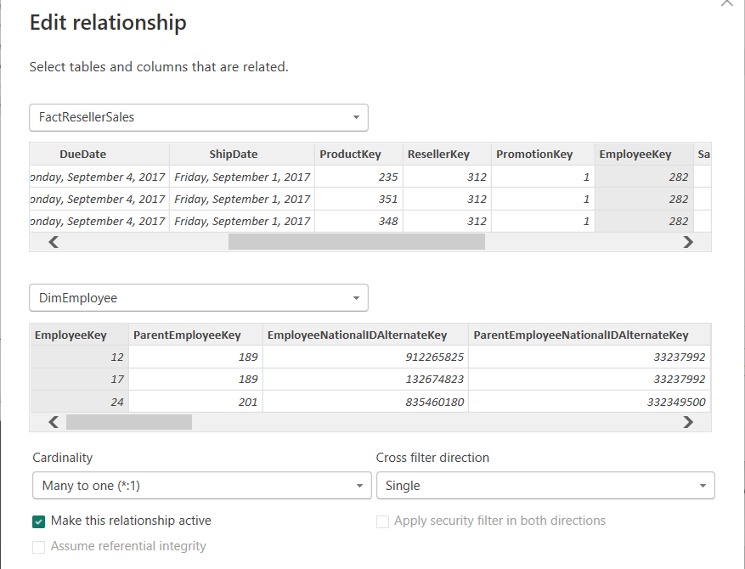
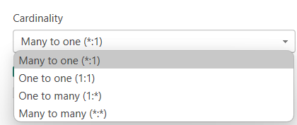
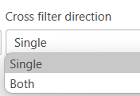
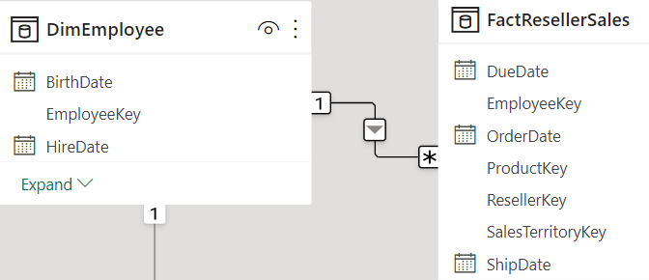
Edit relationships
https://learn.microsoft.com/

Slide 38
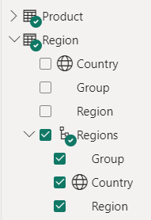
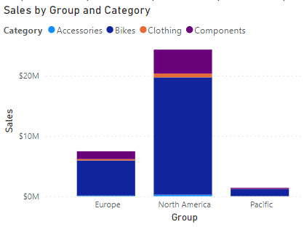
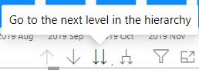
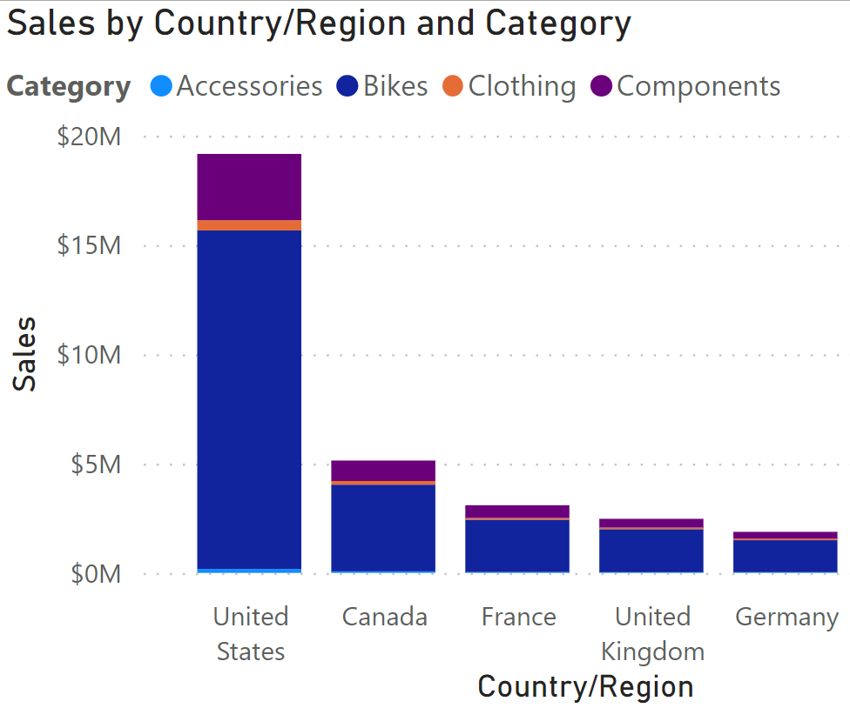
How to use hierarchies for data fields
https://learn.microsoft.com/

Slide 39
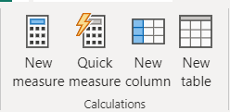
What is DAX?
Data Analysis Expressions
Library of functions and operators
Build formulas and expressions
Create calculated measures, columns, and tables
https://learn.microsoft.com/

Slide 40
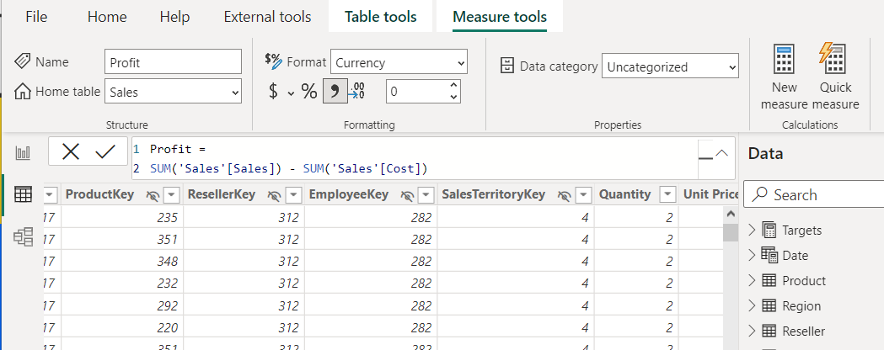

Create calculated measures
Defined with DAX definitions
Computed on the fly.
Not stored in data model.
Responsive to interactions.
Indicated by calculator icon.
https://learn.microsoft.com/

Slide 41


Quick measures
https://learn.microsoft.com/

Slide 42


Create calculated columns
Defined using DAX expressions.
Computed & stored in data model.
Useful “helper/connector columns.”
Recalculated during data refresh.
Table and Sigma icon.
https://learn.microsoft.com/

Slide 43

Create calculated tables
Defined using DAX expressions.
Computed & stored in data model.
Useful for aggregating data or creating custom tables.
Table and calculator icon.
https://learn.microsoft.com/

Slide 44
DAX Data Types
Whole Number (Integer)
Decimal Number (Float)
Currency (Currency), a fixed decimal number internally stored as an integer
Date (DateTime)
Boolean (TRUE/FALSE)
Text (String)
Binary large object (BLOB

Slide 45

DAX operators

Slide 46

dax.guide

Slide 47
Common DAX functions
Aggregate functions
Logical functions
Information functions
Mathematical functions
Text functions
Conversion functions
Date and time functions
Relational functions

Slide 48
Dashboard Design Principle & Data Storytelling

Slide 49


Reference Resource

Slide 50


choosing an effective visual
Simple text

Slide 51

choosing an effective visual
Table
https://learn.microsoft.com/

Slide 52


choosing an effective visual
Vertical bar
Horizontal bar
https://learn.microsoft.com/

Slide 53


choosing an effective visual
Stacked vertical bar
Stacked horizontal bar
https://learn.microsoft.com/

Slide 54


choosing an effective visual
Pie
Donut
https://learn.microsoft.com/

Slide 55

choosing an effective visual
Line

Slide 56

choosing an effective visual
Scatterplot

Slide 57

Add visualizations to Power BI reports
https://learn.microsoft.com/

Slide 58


Import custom visuals from AppSource
https://learn.microsoft.com/

Slide 59


Format and configure visualizations
https://learn.microsoft.com/

Slide 60


Configure conditional formatting
https://learn.microsoft.com/

Slide 61


Use the Slicer visual to provide on-report filtering
https://learn.microsoft.com/

Slide 62




Key Performance Indicator visual
https://learn.microsoft.com/

Slide 63

AI Insights for data preparation in Power Query Editor
Leverage AI analysis of text, images, and use Azure Machine Learning models.
https://learn.microsoft.com/

Slide 64


AI in the Q&A feature
Use natural language to ask questions about data and create visuals for insights.
https://learn.microsoft.com/

Slide 65

Key influencers visual
Identify factors driving variations in a chosen target metric.
https://learn.microsoft.com/

Slide 66

Decomposition tree visual
Visualize data hierarchies for in-depth exploration and pattern discovery.
https://learn.microsoft.com/

Slide 67
Business Dashboard Concept

Slide 68

Sales and Profit Margin
https://learn.microsoft.com/

Slide 69



Variance and Variance Margin
https://learn.microsoft.com/

Slide 70

Aggregate Price
https://learn.microsoft.com/

Slide 71


Sales Dashboard Example
https://learn.microsoft.com/

Slide 72


Sales Dashboard Example
https://learn.microsoft.com/

Slide 73


YTD measure
https://learn.microsoft.com/

Slide 74


YoY growth measure
https://learn.microsoft.com/

Slide 75


Sales Forecast
https://learn.microsoft.com/

Slide 76


Thank you

